Slide 1
Principal Component Analysis - PCA

Slide 2
Principal Component Analysis - PCA
Noise filtering
Visualization
Feature Extraction
Stock market predictions
Gene data analysis

Slide 3
Principal Component Analysis - PCA
Identify patterns in data
Detect the correlation between variables

Slide 4
Principal Component Analysis - PCA
Reduce the dimensions of a d-dimensional dataset by projecting it onto a (k)-dimensional subspace (where k<d)

Slide 5
Principal Component Analysis - PCA
• Standardize the data.
• Obtain the Eigenvectors and Eigenvalues from the covariance matrix or correlation matrix, or perform Singular Vector Decomposition.
• Sort eigenvalues in descending order and choose the k eigenvectors that correspond to the k largest eigenvalues where k is the number of dimensions of the new feature subspace (k≤d)/.
• Construct the projection matrix W from the selected k eigenvectors.
• Transform the original dataset X via W to obtain a k-dimensional feature subspace Y
https://plot.ly/ipython-notebooks/principal-component-analysis/

Slide 6
Linear Discriminant Analysis - LDA
Notes:
There obviously is a pattern here, but how do we model it??

Slide 7
Linear Discriminant Analysis - LDA

Slide 8
Linear Discriminant Analysis - LDA
Used as a dimensionality reduction technique
Used in the pre-processing step for pattern classification
Has the goal to project a dataset onto a lower-dimensional space
Notes:
There obviously is a pattern here, but how do we model it??

Slide 9
Linear Discriminant Analysis - LDA
Sounds similar to PCA right?
LDA differs because in addition to finding the component axises with LDA we
Are interested in the axes that maximize the separation between multiple
classes.
Notes:
There obviously is a pattern here, but how do we model it??

Slide 10
Linear Discriminant Analysis- LDA
Breaking it down further:
The goal of LDA is to project a feature space (a dataset n-dimensional samples) onto a small subspace subspace k(where k≤n−1) while maintaining the class-discriminatory information.
Both PCA and LDA are linear transformation techniques used for dimensional reduction. PCA is described as unsupervised but LDA is supervised because of the relation to the dependent variable.
Notes:
There obviously is a pattern here, but how do we model it??

Slide 11
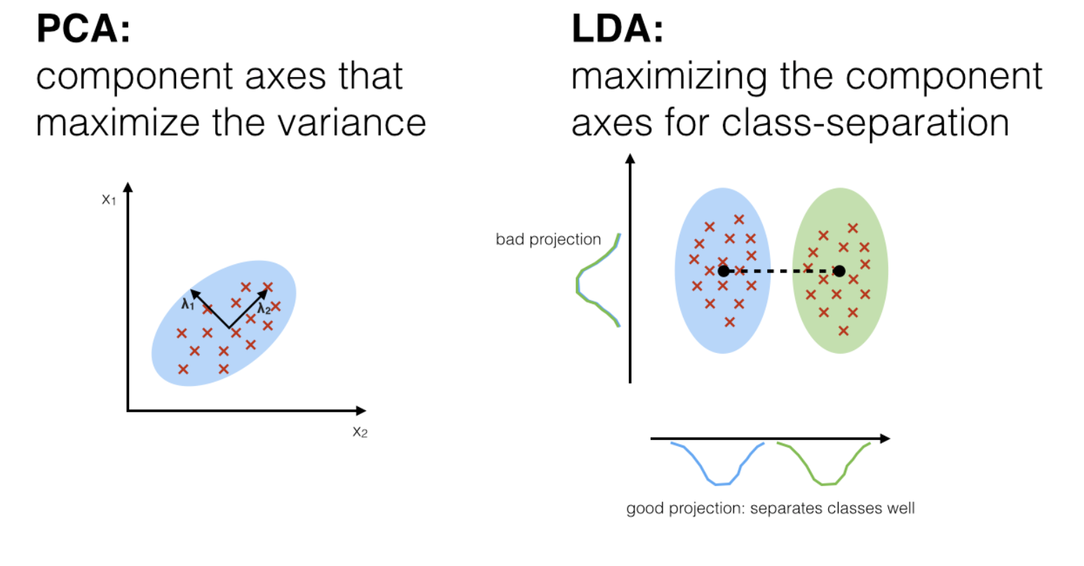
Linear Discriminant Analysis - LDA
LDA: https://sebastianraschka.com/Articles/2014_python_lda.html

Slide 12
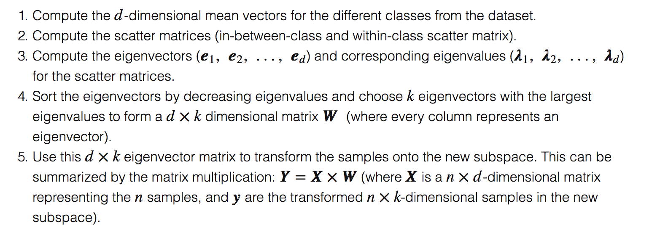
Linear Discriminant Analysis - LDA
https://sebastianraschka.com/Articles/2014_python_lda.html

Slide 13
Linear Discriminant Analysis - LDA

Slide 14
Support Vector Regression - SVR
How does it work?

Slide 15


Support Vector Regression - SVR
Building a SVR
Collect a training set T = {X, Y}
2. Choose a kernel and it’s parameters as well as any regularization needed.
3. Form the correlation matrix, K
4. Train your machine, exactly or approximately, to get contraction coefficients
5. Use those coefficients, create your estimator

Slide 16
Support Vector Regression - SVR
Next step is to choose a kernel
Gaussian
Regularization
Noise

Slide 17
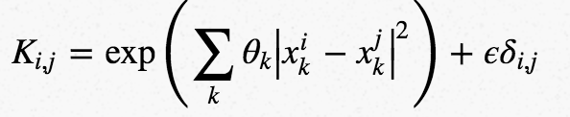
Support Vector Regression - SVR
Correlation Matrix

Slide 18


Support Vector Regression - SVR
The main part of the algorithm
y is the vector of values corresponding to your training set,
K is your correlation matrix
α is a set of unknowns we need to solve for.
Notes:
There obviously is a pattern here, but how do we model it??

Slide 19
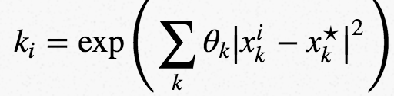
Support Vector Regression - SVR
Once α parameters known - form the estimator
we use the coefficients we found during the optimization step and the kernel we started off with.
To estimate the value y* for a test point, x* - compute the correlation vector k,
y* = α ⋅k

Slide 20
Support Vector Regression - SVR
Let’s try to simplify everything:
SVR has a different regression goal compared to linear regression. In linear regression we are trying to minimize the error between the prediction and data. In SVR our goal is to make sure that errors do not exceed the threshold.

Slide 21
Support Vector Regression - SVR
https://link.springer.com/chapter/10.1007/978-1-4302-5990-9_4

Slide 22
Support Vector Regression - SVR
Notes: SVR is very useful for:
Since you are able to generate training points you then know what the “right” is. But it may be expensive to compute the answer for every new point needed.
SVR and in particular gaussian processes are a very good method to use for efficient computations, by pre-computing a training set and then using a SVR machine to interpolate the results.

Slide 23
Support Vector Regression - SVR
In a classification problem, the vectors X are used to define
a hyperplane that separates the two different classes in your solution.
These vectors are used to perform linear regression. The vectors closest to the test point are referred to as support vectors. We can evaluate our function anywhere so any vectors could be closest to our test evaluation location.
Gaussian processes are a particular form of SVM. The difference between the two lies in choice of kernel and loss function. The functional form of the kernel determines which vectors in your training set most strongly influence the regression and the form of your estimator. The loss function choice determines the coefficients used in regression. Together these two pieces totally determine the form and accuracy of your estimator. Although this makes it sound like the two are totally different, the spirit of the two are identical.

